Slide 1

Project 2
Team Lead: Michael Hayes
Theodore Hartin
Nathanael Mottonen
Nathaniel Shenk
Zachery Brinner

Slide 2
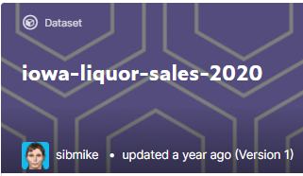

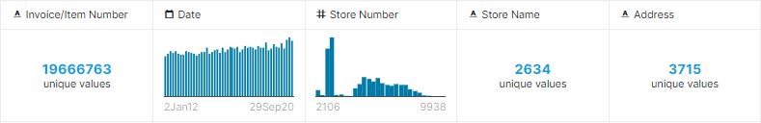
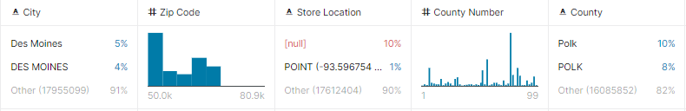
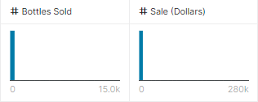
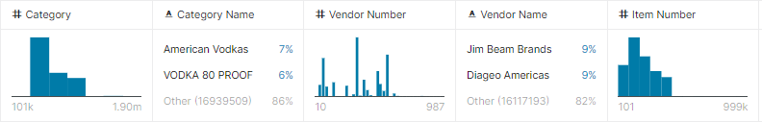
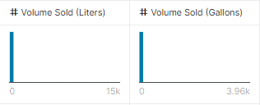
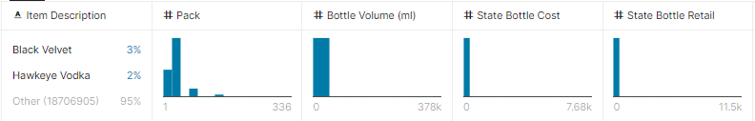
Data Source
Data on liquor transactions in Iowa from January 2, 2012 to September 29, 2020

Slide 3
Is there a change in the amount (volume and total sales) of liquor sales depending on the Year? Month? Around Holidays?

Slide 4
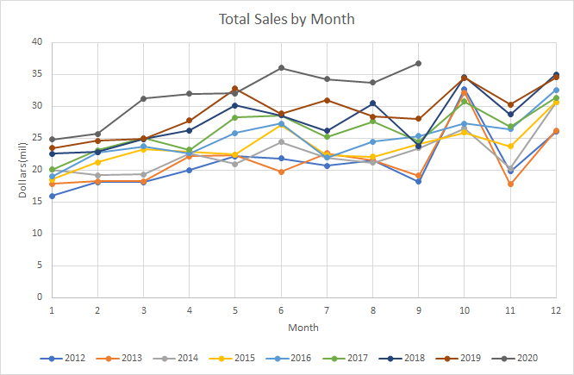
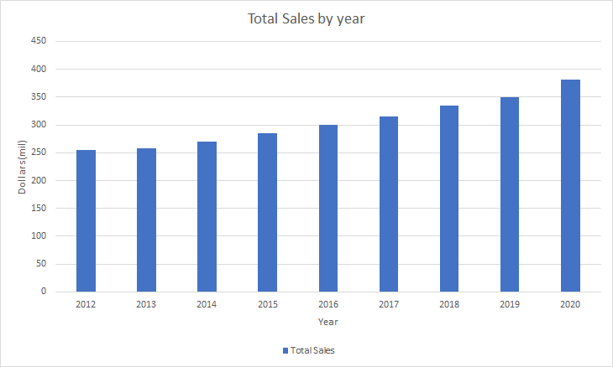
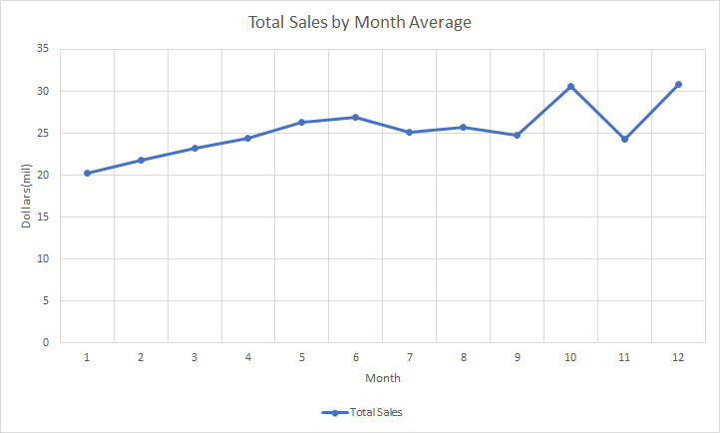
Total Sales by Year and by Month
NOTE: Data from year 2020 extrapolated based on average from months Jan. – Sept.
Notes:
-Theo: When you point out the increase in money spent on alcohol over time (bar chart), remember to mention in the disclaimer about inflation.
That would also allow for a smooth transition between this slide and the next; you could say something like "Although inflation may artifically
Inflate these sales numbers over time, ~next slide~ volume also displays a similar pattern... "

Slide 5
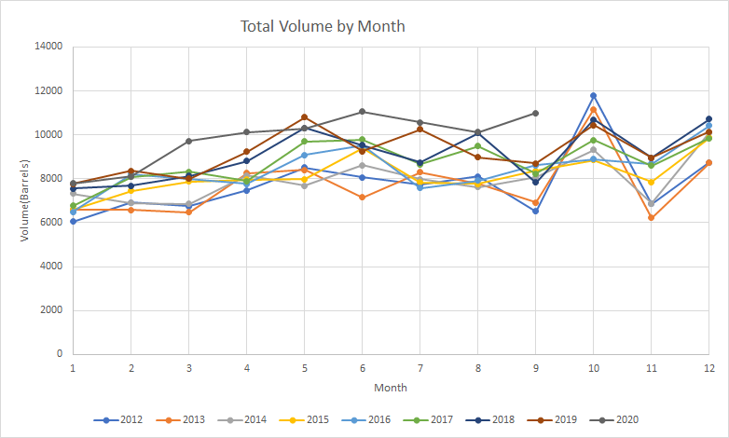
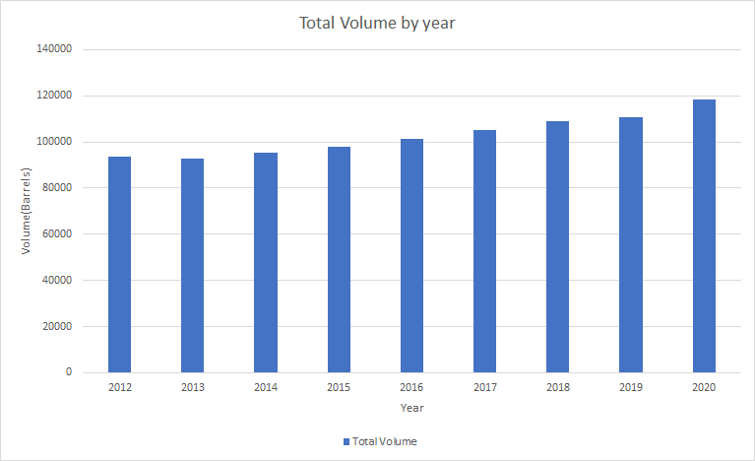
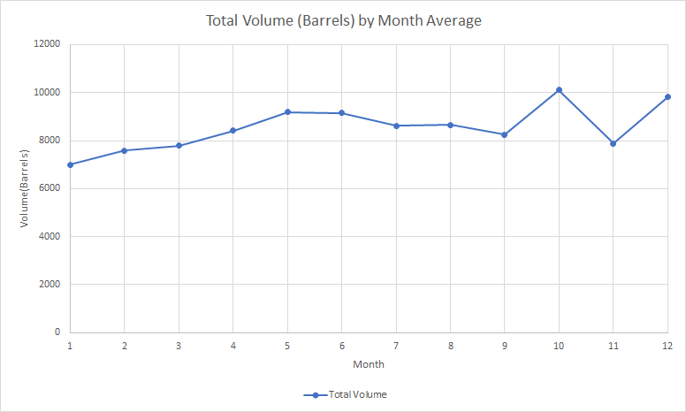
Total Volume Sold by Year and by Month
NOTE: Data from year 2020 extrapolated based on average from months Jan. – Sept.
Notes:
-Theo: is the data from 2020 'interpolated' or 'extrapolated'?
-Theo: I did some research to try and figure out the massive uptick in alcohol purchases in October, and it turns out the second largest immigrant population
To settle in Iowa were German; I think that increase might come from Oktoberfest festivals.
Also, New year's is regarded as the 'drunkest' holiday, which most likely explains the bump at the end of the year
-Theo: Talking Point - It's interesting that 2012 had 3 of the lowest volume months on record (January, April, and Septmber) AND the highest month on record (October)
And there's a similar pattern in 2013 (all-time lows for Feb, March, Jun, Nov, and second highest month of all time, October). Also, 2012 and 2013 appear
Tied for lowest volume in December

Slide 6
Holiday Sales

Slide 7
Holiday Volume Sold

Slide 8
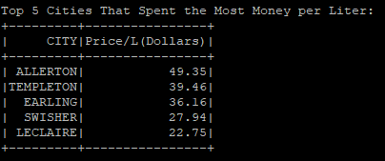
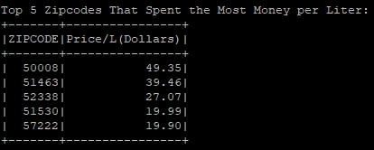
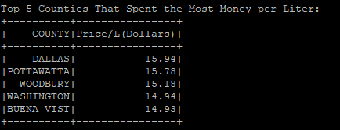
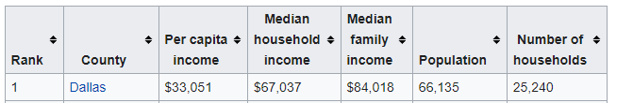
Which locale buys the most expensive liquor?
By City:
By Zipcode:
By County:
https://en.wikipedia.org/wiki/List_of_Iowa_locations_by_per_capita_income
Notes:
Theodore Hartin
-Speak to the difference in per capita income of Dallas county and Buena Vista (https://en.wikipedia.org/wiki/List_of_Iowa_locations_by_per_capita_income)

Slide 9
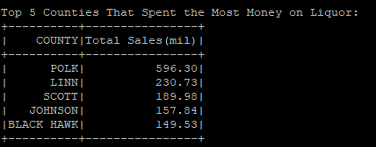
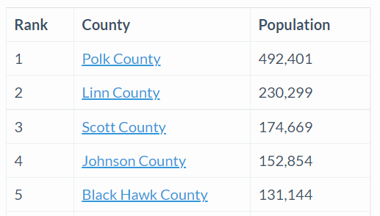
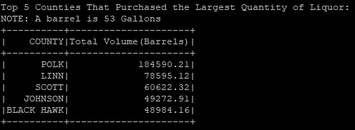
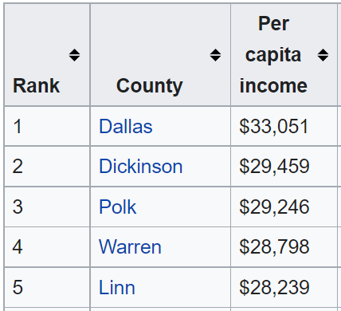
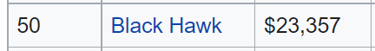
County Comparison
Total Sales
Population
Volume
Data
1. Polk County = $596 mil.
2. Linn County = $230 mil.
Polk:
3% Higher Income than Linn
however
Spent 21% more on Alcohol
County | $1k/Person | Barrels/Person
Polk | 1.21 | 0.38
Linn | 1.00 | 0.34
Scott | 1.09 | 0.34
Johnson | 1.03 | 0.32
Black Hawk | 1.14 | 0.37
Analysis
Black Hawk:
21% Lower Income than Linn
however
Spent 14% more on Alcohol
Notes:
Theodore Hartin
- Comparing counties, Total sales in Mil on the left, total volume in Barrels on the right (a barrel of alcohol is roughly 53 gallons)
-Draw attention to the left, sales. If you notice, the county which had the highest total sales polk, sold 596 mil where as the county with the
Second highest sales only sold 230 mil, less than half. This may lead you to believe that the people of polk county
Drink far more than the people in any other county, but we must first take into account how many people actually live in the county
The table compares the sales and volume figures against the population and as you can see, the numbers are not quite as dramatic.
-Although polk county as a whole spent more than double the money on alochol then Linn county, the average polk citizen only spent 20%
More than the average linn citizen, with the person in polk spending $1,200 and linn spending only $1k.

Slide 10
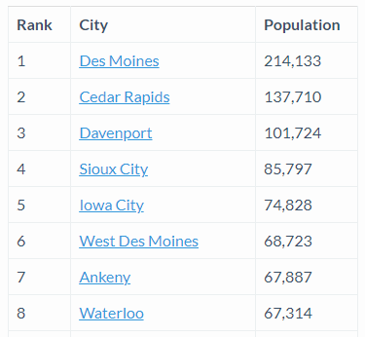
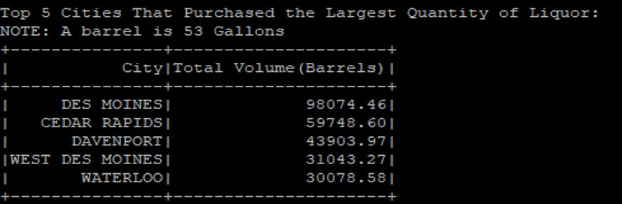
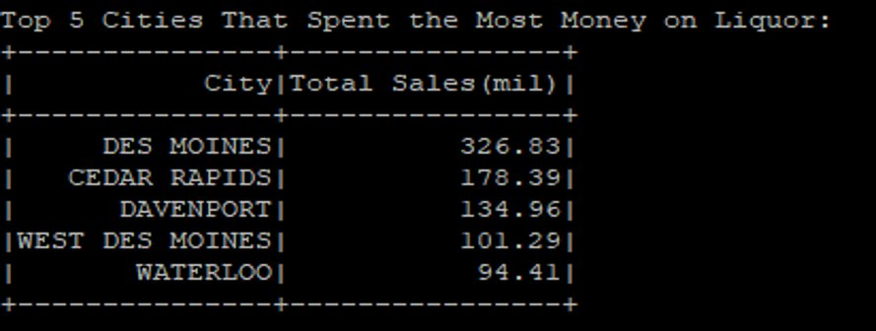
City Comparison
Total Sales
Population
Volume
Data
1. Des Moines = 98k Barrels
2. Cedar Rapids = 60k Barrels
City | $1k/Person | Barrels/Person
Des Moines | 1.53 | 0.46
Cedar Rapids | 1.29 | 0.43
Davenport | 1.31 | 0.43
West Des Moines | 1.46 | 0.45
Waterloo | 1.40 | 0.45
*m = month
Des Moines:
.45 Barrels ≈ 25 gallons = .24 gal/m = .91L/m = 30.78 oz/m
98k Barrels
144 Liquor lic.
= 680 Bar./LL
†
=
Analysis
Cedar Rapids:
20.5 Drinks per Month per Person**
60k Barrels
80 Liquor lic.
= 750 Bar./LL
†
10% More Volume per Licensed Seller in Cedar Rapids
** 1 Drink is equivalent to 1.5 US fluid ounces of a
distilled spirits
†
https://elicensing.iowaabd.com/LicenseSearch.aspx
Notes:
Theodore Hartin
-Comparing Cities. Draw attention to right to discuss volume
- An Olympic swimming pool holds 660,000 gallons; Des Moines consumed roughly 7.87 pools worth of alcohol
Over the timeframe, which equates to about 1 pool of liquor per year

Slide 11
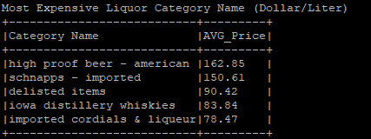
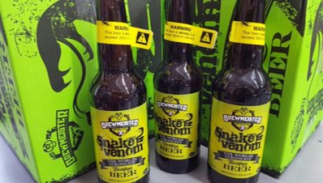
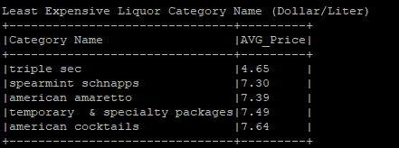
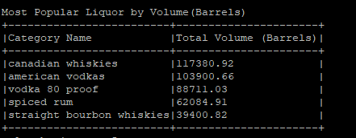
Which category of liquor is the most expensive? Inexpensive? Most popular category?

Slide 12
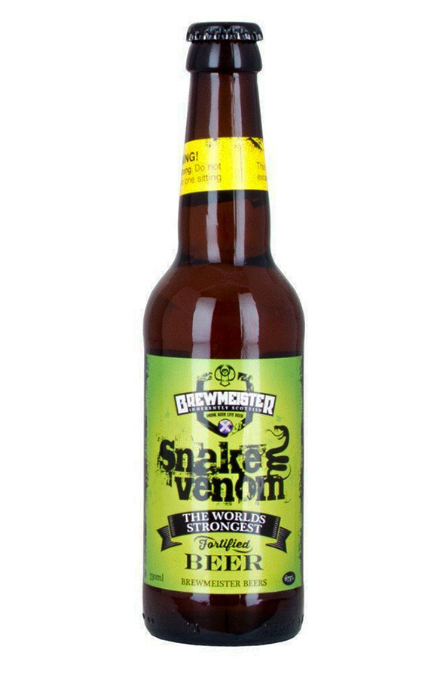
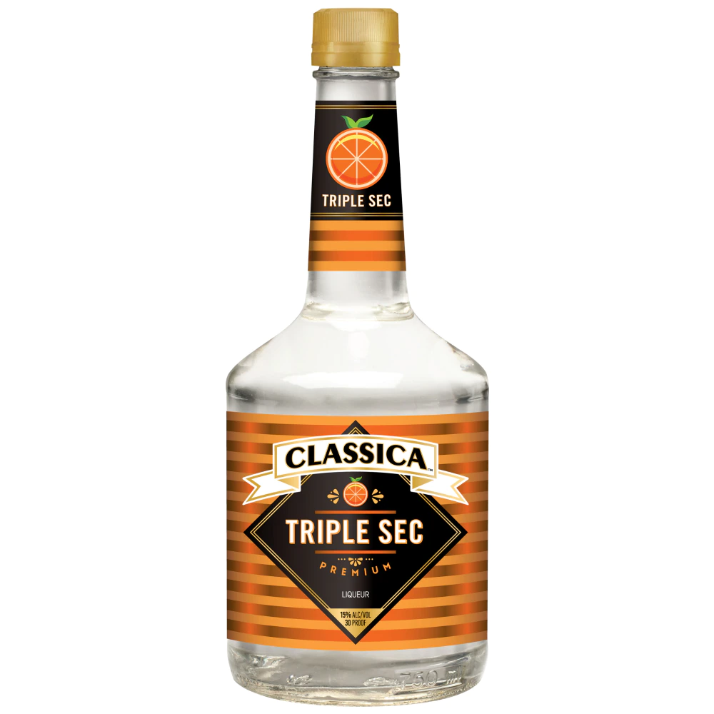
Liquor Most Expensive, Liquor Least Expensive
BEER
High ABV %
Mixers. Cocktail Sweetener
Notes:
High Proof Beer 60+ ABV%
Orange Citrus Flavored Mixers, low alcohol content

Slide 13
Most Popular Category
Notes:
Canadian Whiskies- Crown Royal
American Vodkas- Titos

Slide 14
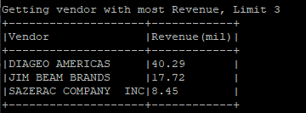

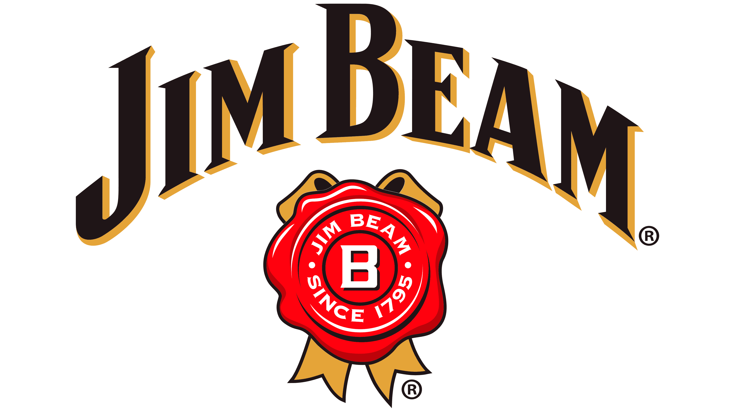

Which vendor made the most on liquor sales? What was their best-selling category?
Notes:
-Theo: Diageo Brands: https://www.diageo.com/en/our-brands/brand-introduction/
-Smirnoff and Captain Morgan
Jim Bean Brands: https://en.wikipedia.org/wiki/Beam_Suntory
-Jim Beam
Sazerac Brands: https://www.sazerac.com/our-brands/sazerac-brands.html
-Fireball, Southern Comfort

Slide 15
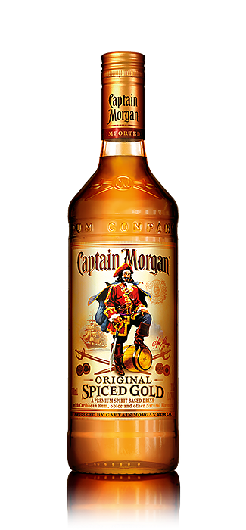
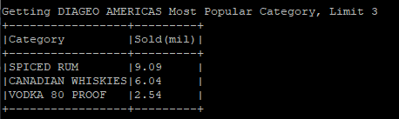
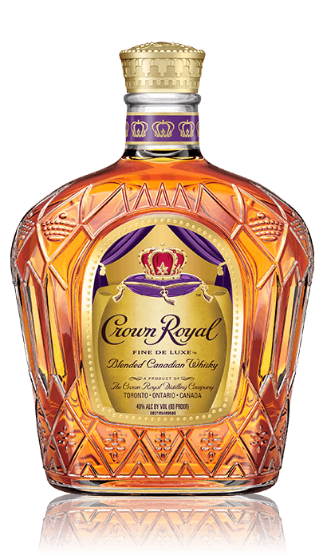
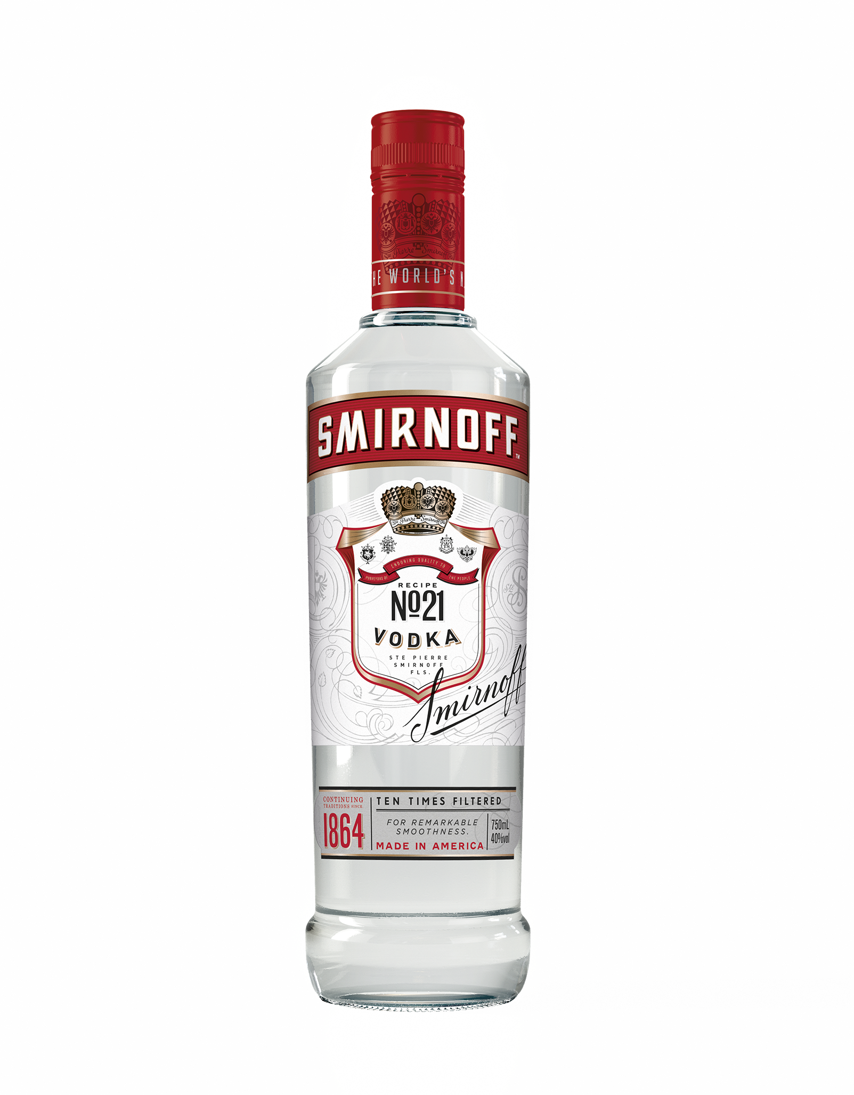

Slide 16
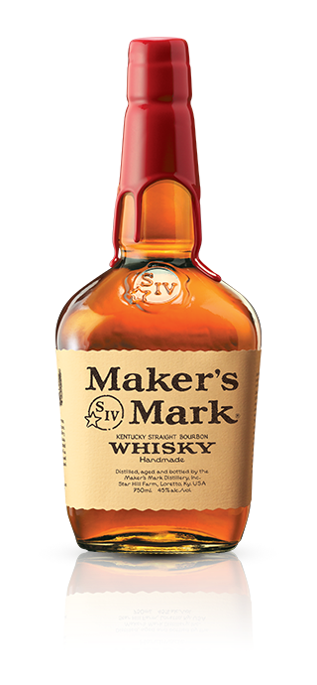
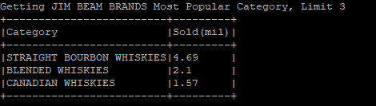
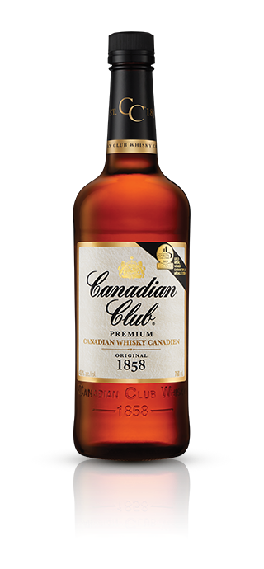
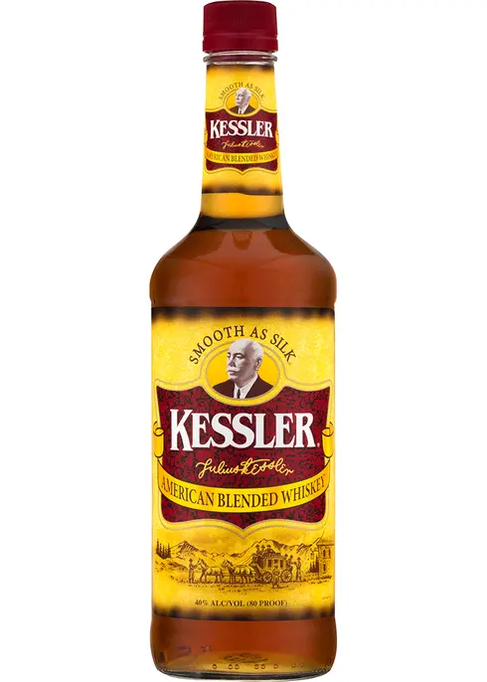

Slide 17
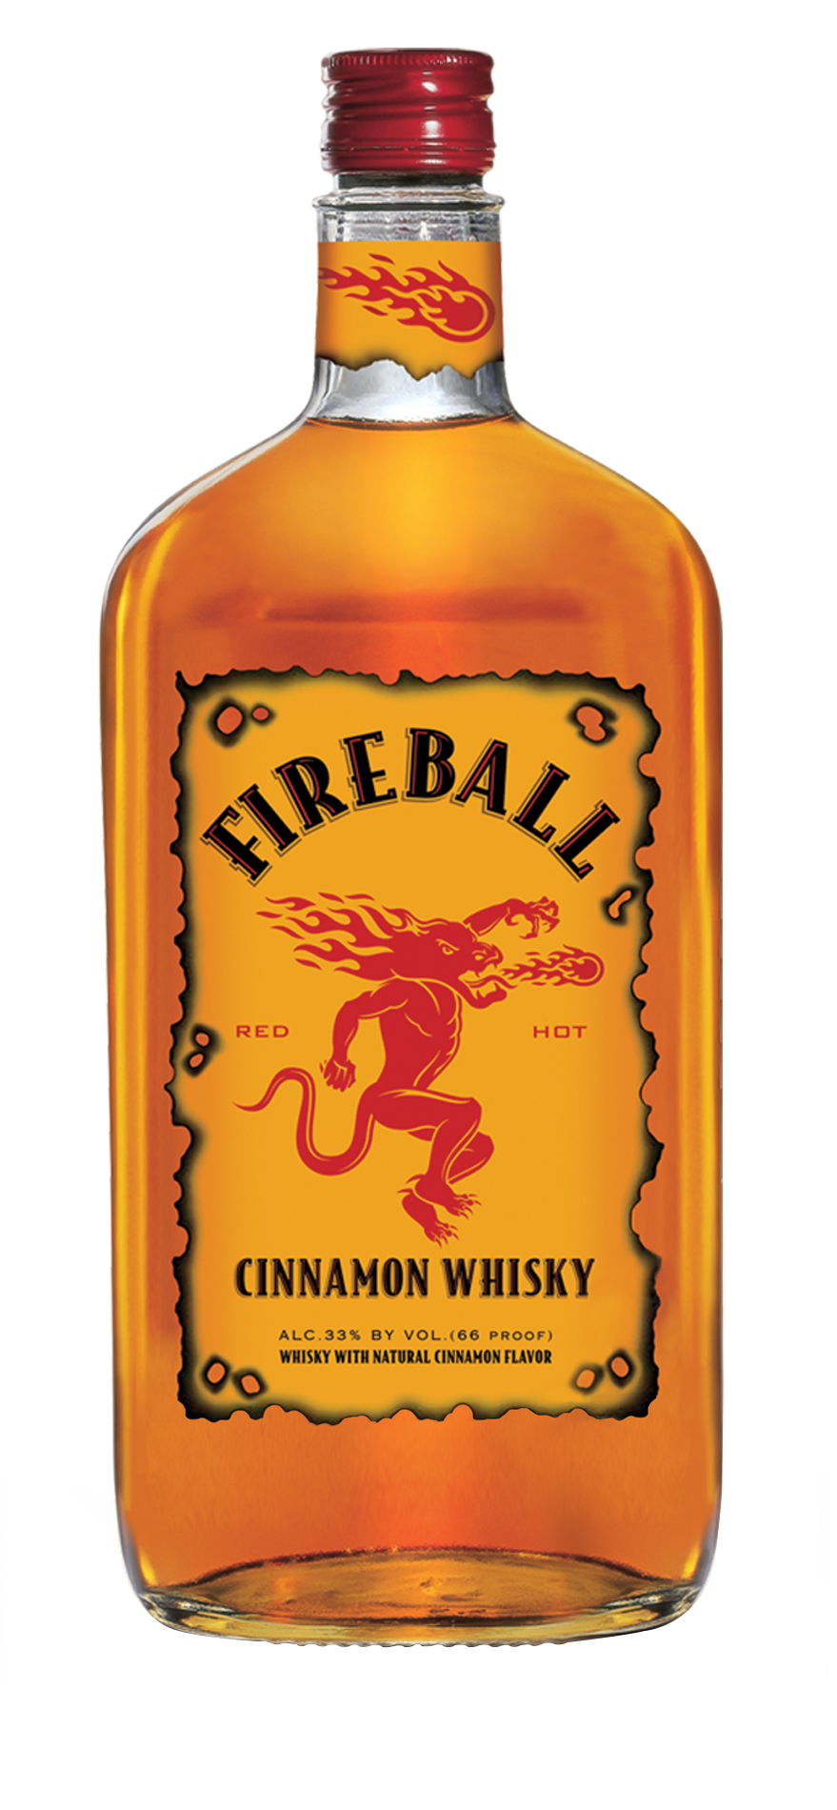
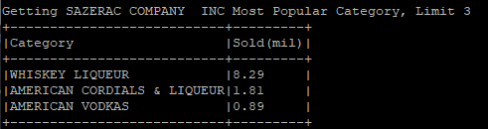
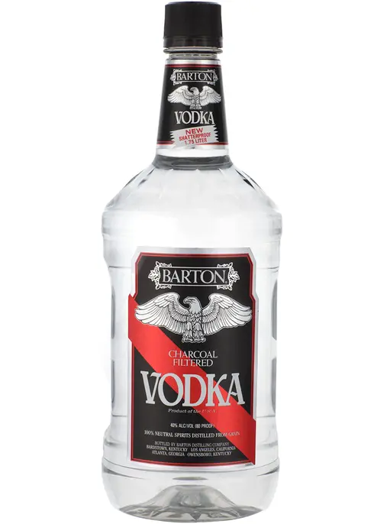
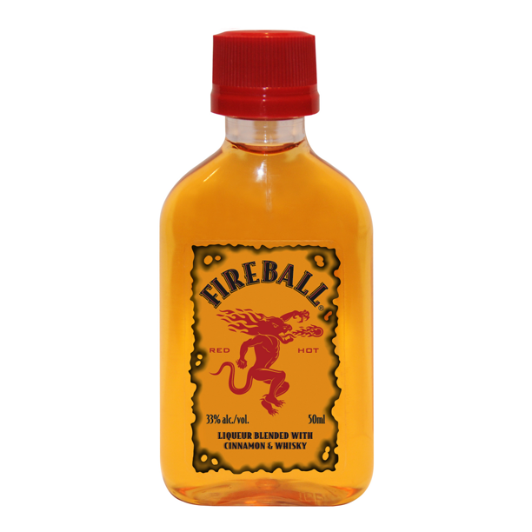

Slide 18
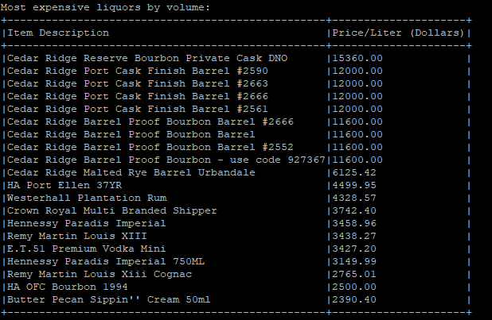
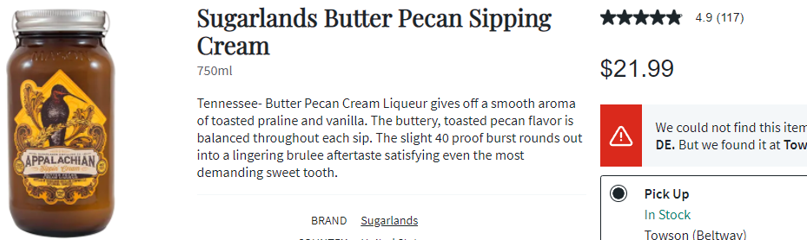
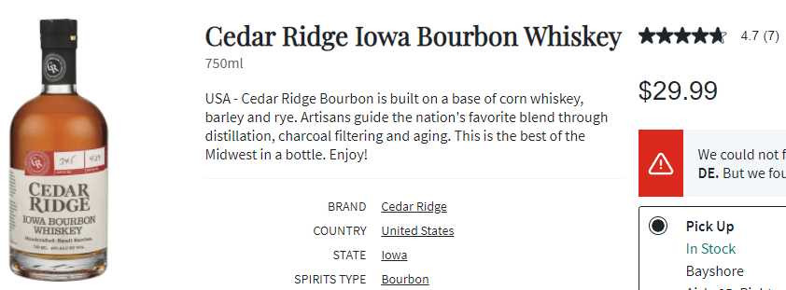
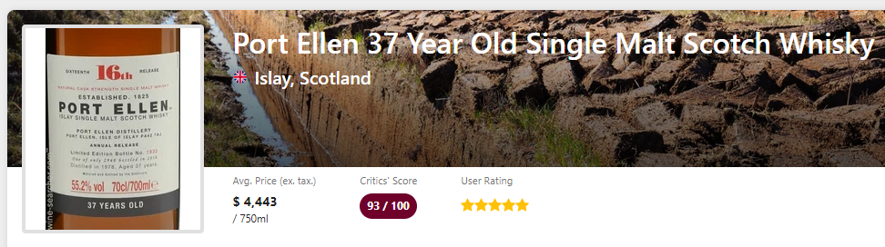
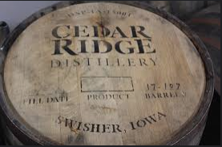
Which liquors are the most expensive?
Notes:
Discrepancies: Barrels significantly more expensive: data errors (shown on next slide)
Notes:
- Remy Martin Louis XIII – Popularly known for its high price
-Theo: This is a good opportunity to talk about the importance of data quality. One discrepancy has already been identified
In the first table; there's also a 'duplicate' record for 2nd and 3rd place.

Slide 19

Discrepancies explained
11520/.75 = $15,360 Wrong volume? Retail price for 750ml ($30) extended to 53 gallons (barrel) = ~$6000
119.52/0.05 = $2390.40 Wrong sale (but there's an exact price)? Bottles sold?

Slide 20


Which liquors are the least expensive?
More data inconsistencies:
- Two "Mr. Boston Triple Sec"s
- $0.63 Whiskey Mini?
Wrong bottle volume? Sale (Dollars)? Pack size??
Notes:
Discrepancies: Whiskey mini much cheaper than others, there's also a 'duplicate' record for 2nd and 3rd place.
Notes:
- 7/10 least expensive are triple secs

Slide 21





Which liquors are the most popular by Volume? Most popular by total sales?
Key:
= Liquors in top 10 most popular by volume but not dollars spent
= Liquors in top 10 most popular by dollars spent but not volume
*None of the least or most expensive liquors (by price/liter) appear in either table
Notes:
Noteworthy changes:
- Hawkeye Vodka: 2nd in liters sold, 6th in dollars spent
- Captain Morgan: 3rd in liters, less than 10th in dollars spent
- Jack Daniels Old #7 Black Label: 9th in liters, 4th in dollars
- Crown Royal: Unranked liters, 7th and 8th in dollars
- None of the most or least expensive by volume appear in either table

Slide 22




Liquors with the highest and lowest average profit margins
425.16/36 = $11.81
Notes:
-Theo: Be prepared to explain the negative profit margins

Slide 23

Is there a change in the amount (volume and total sales) of liquor sales due to COVID-19?

Slide 24


Which day of the week contains the most alcohol purchases?
Notes:
More confirmation. Monday is the worst.
No body procrastinate for the weekend. Bars?

Slide 25
Optimization
The dataset comes in CSV format.
By converting the CSV to a parquet file, the performance of the queries improved significantly.
Nearly 3 times the performance increase!!!
Question | Before | After
1 | 13:47 | 3:02
2 | 2:40 | 1:04
3 | 2:39 | 1:28
4 | 1:15 | 0:13
5 | 2:37 | 0:40
6 | 1:51 | 0:19
7 | 0:52 | 0:07
8 | 0:02 | 0:02
9 | 0:33 | 0:17
Total | 21:16 | 7:12
 | Time Saved | 14:04
 | Conversion Time | 1:18
 | First Run Time Saved | 12:46
 | Subsequent Runtime | 14:04

Slide 26

Questions?

